Slide 1

CPSC 319 Data Structures, Algorithms, and Their Applications Winter 2024

Slide 2
Recursion
A programming concept where a function calls itself to solve a problem.
Continues until a base case is reached, returning a result without further recursive calls.
Factorial:
Definition:
n! = n × (n-1) × … × 2 × 1
Recursive relation:
f(n) = f(n-1) × n
f(0) = 1

Slide 3
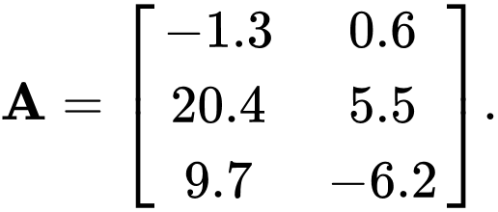
Matrix
A matrix is a two-dimensional array of numbers, symbols, or expressions arranged in rows and columns.
Denoted by an uppercase letter, such as A.
Matrix Elements: a_{ij} represents the element in the i-th row and j-th column of matrix A.
Matrix Size: m×n indicates a matrix with m rows and n columns.

Slide 4
Matrix Operations
Addition:
C = A + B for matrices A, B, and C of the same size.
c_{ij} = a_{ij} + b_{ij}
Subtraction:
C = A - B for matrices A, B, and C of the same size.
c_{ij} = a_{ij} - b_{ij}
Scalar Multiplication:
C = k ⋅ A for a scalar k and matrix A.
c_{ij} = k ⋅ a_{ij}
Matrix Multiplication:
C = A × B for matrices A, B, and C with appropriate dimensions.
c_{ij} = ∑_{k=1}^{n} a_{ik} ⋅ b_{kj}
Transpose:
B = A^{T} where B is the transpose of A.
b_{ij} = a_{ji}

Slide 5
Exponentiation
Exponentiation is the process of raising a number (base) to a certain power (exponent).
Definition:
n^{m} = n × n × … × n (m times)
Recursive relation 1:
f(n, m) = f(n, m-1) × n
f(n, 1) = n
Recursive relation 2:
If m is odd:
f(n, m) = f(n, m/2) × f(n, m/2) × n
If m is even:
f(n, m) = f(n, m/2) × f(n, m/2)
f(n, 1) = n

Slide 6
System.nanoTime()
Precision:
Provides nanosecond precision.
Suitable for measuring short durations or intervals.
Origin:
The origin (zero point) is arbitrary and may change between runs or system restarts.
Not tied to the system clock; it measures elapsed time from an unspecified point in the past.
Use Cases:
Measuring short intervals or time spans.
Profiling and performance monitoring.
Benchmarking code execution time.

Slide 7
System.currentTimeMillis()
Precision:
Provides millisecond precision.
Suitable for measuring longer durations.
Origin:
The origin is the standard Unix epoch (January 1, 1970, UTC).
Tied to the system clock and reflects wall-clock time.
Use Cases:
Dealing with real-world time, such as timestamps.
Calculating date differences.
Scheduling tasks based on absolute time.

